Slide 1
Surface Noise in Oceanographic Measurements
DFO and HSC sourced Data

Slide 2
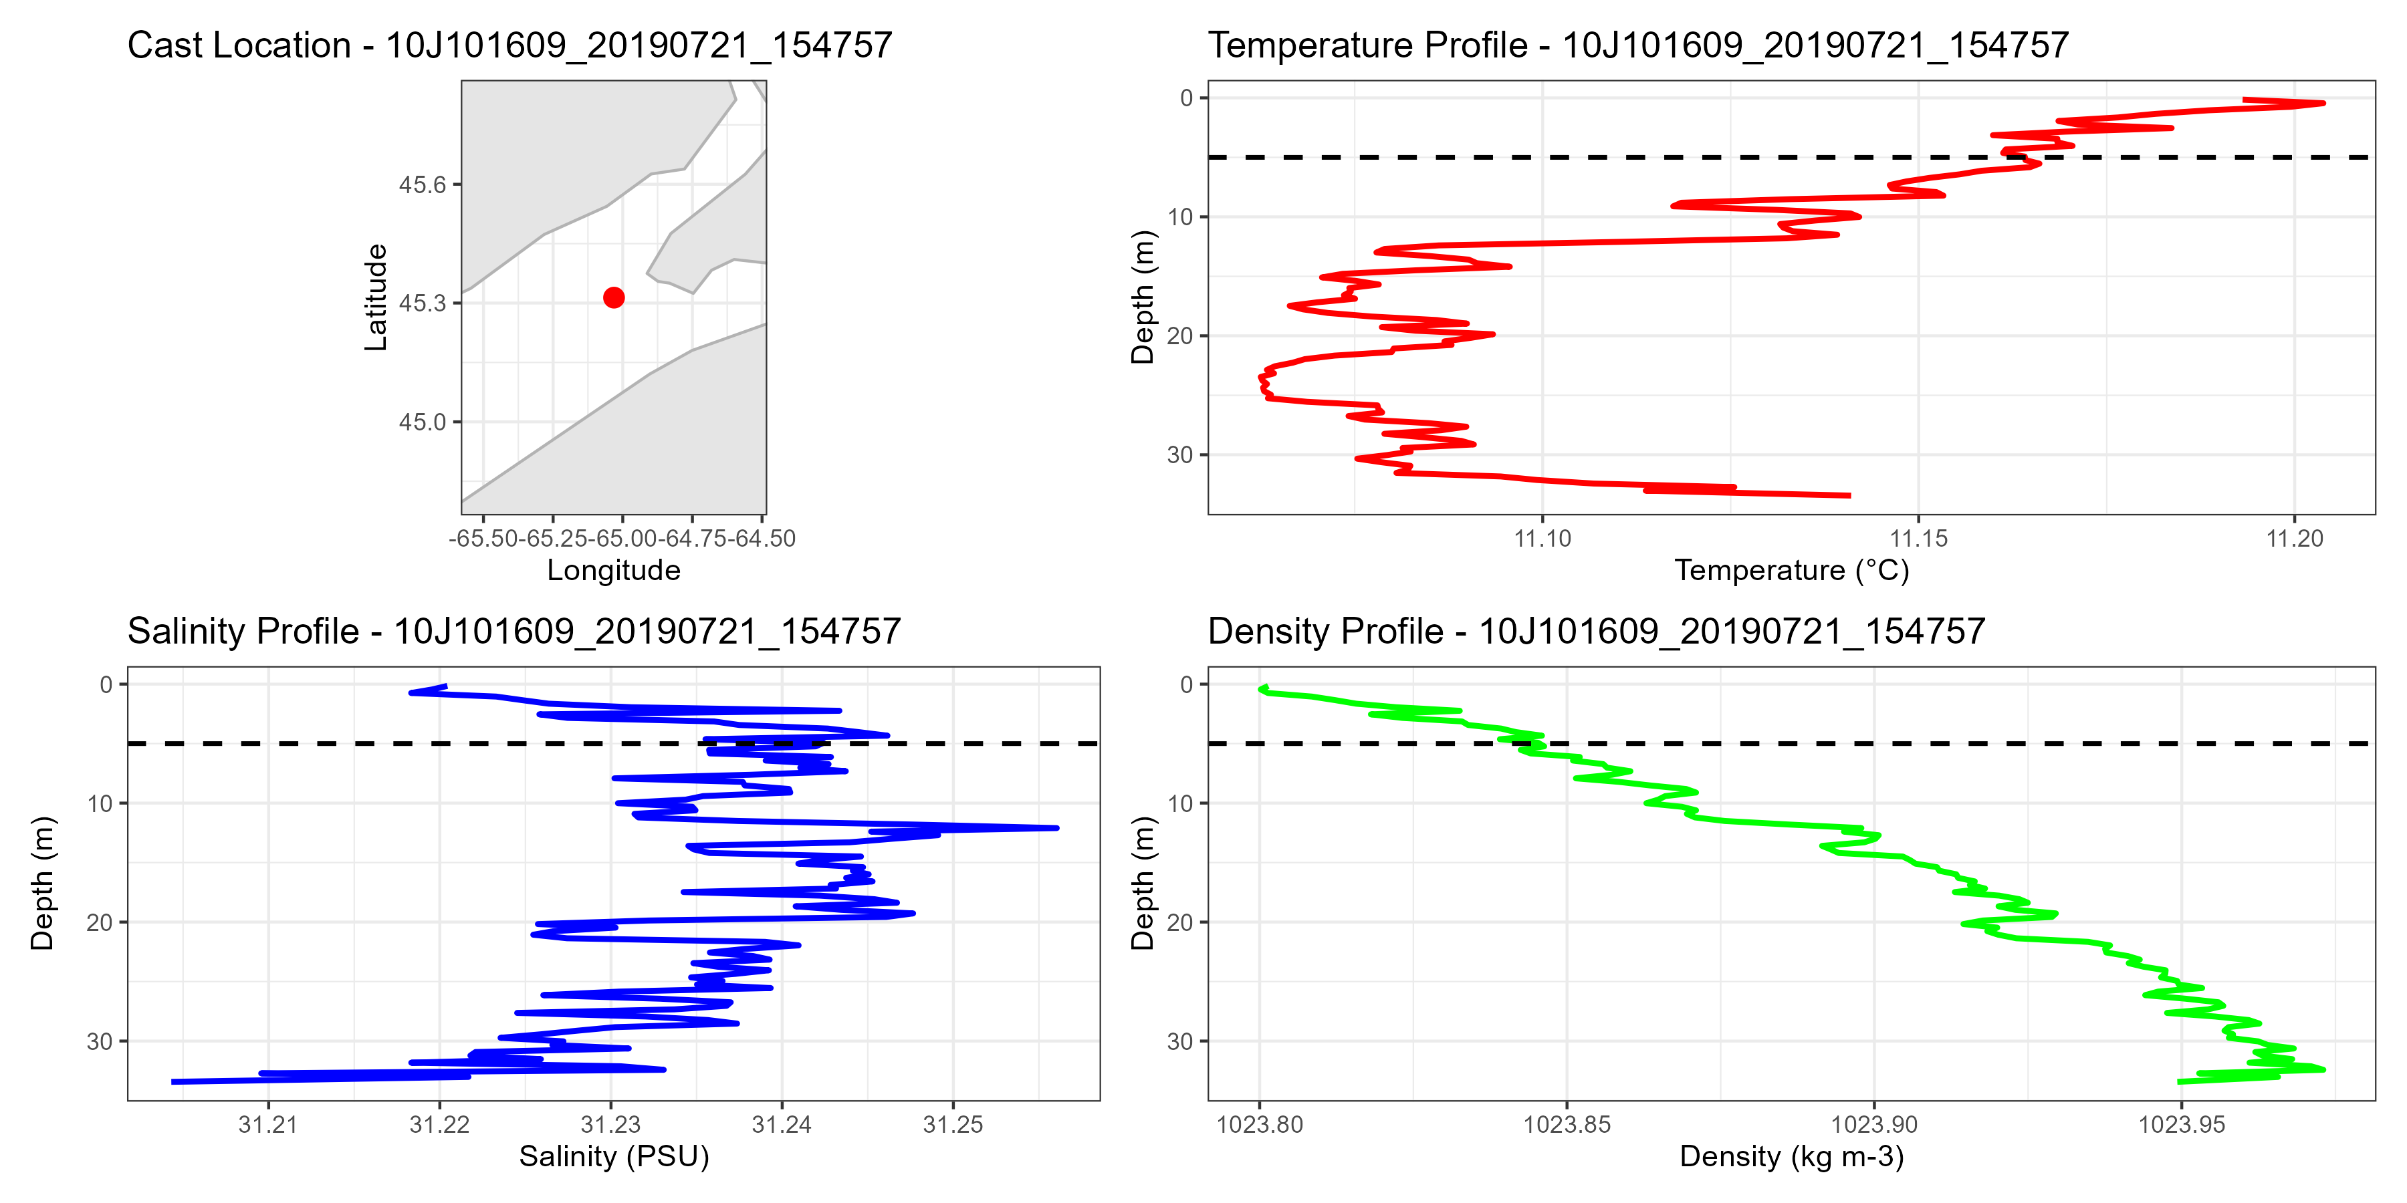
HSC Examples
Scots Bay July 21, 2019

Slide 3
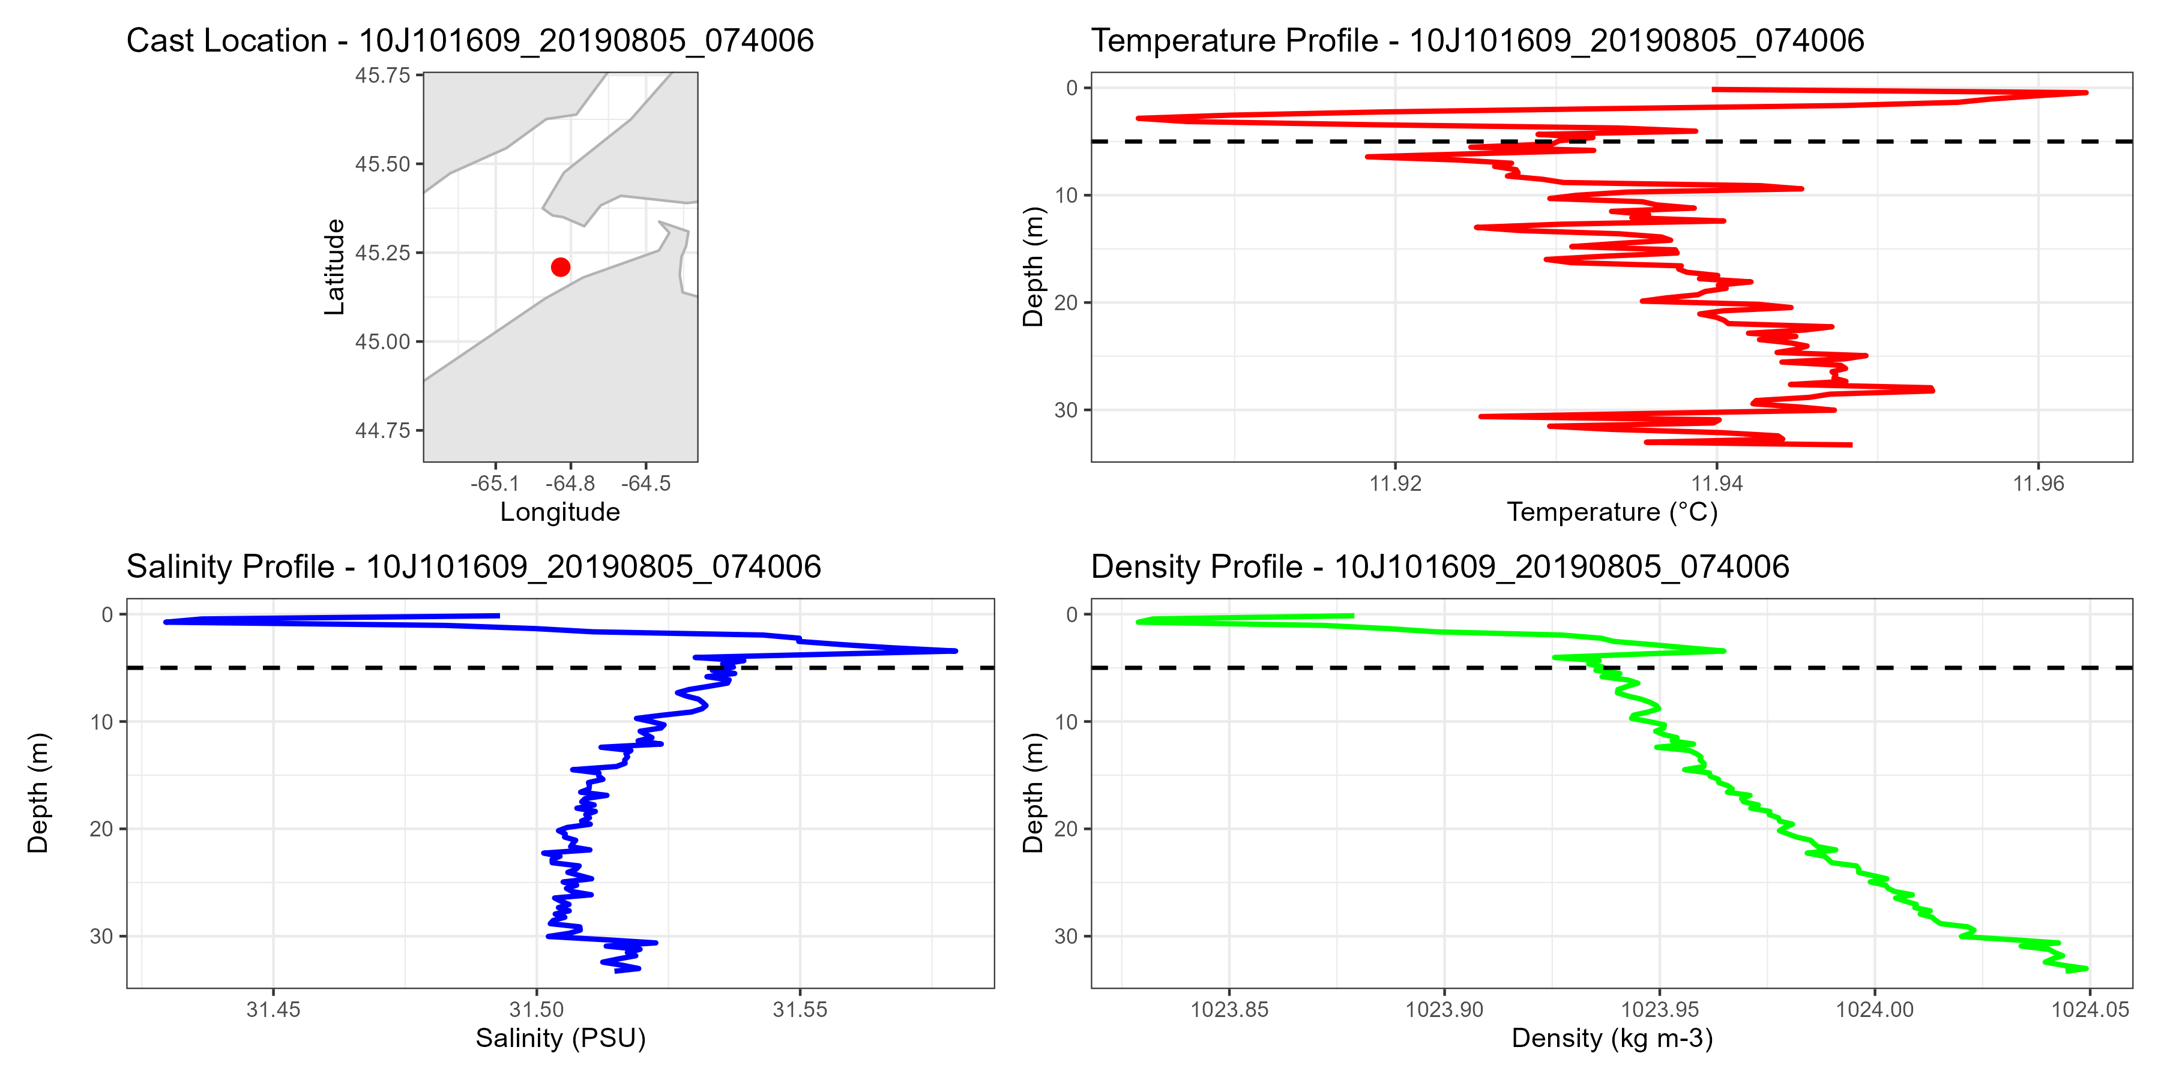
Scots Bay August 5, 2019
Upper 5m
Temperature and salinity

Slide 4
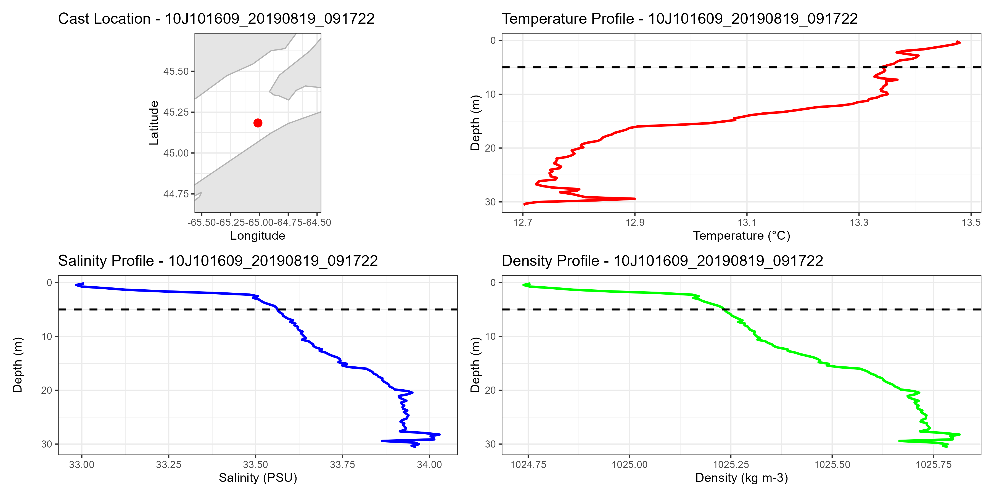
Scots Bay August 18, 2019
Upper 2.5m
Temperature and salinity

Slide 5
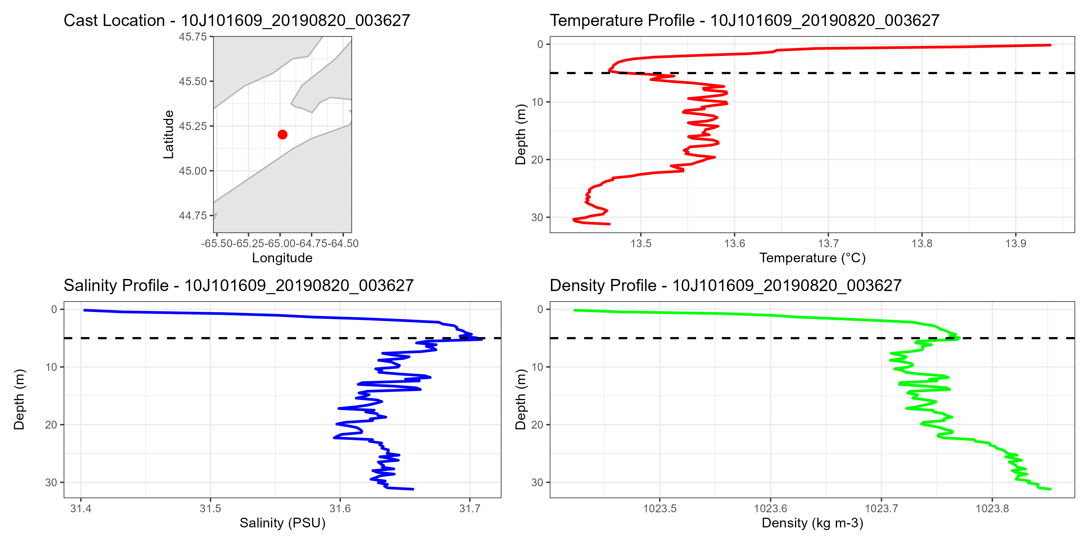
Scots Bay August 20, 2019
Upper 5m
Temperature and salinity

Slide 6
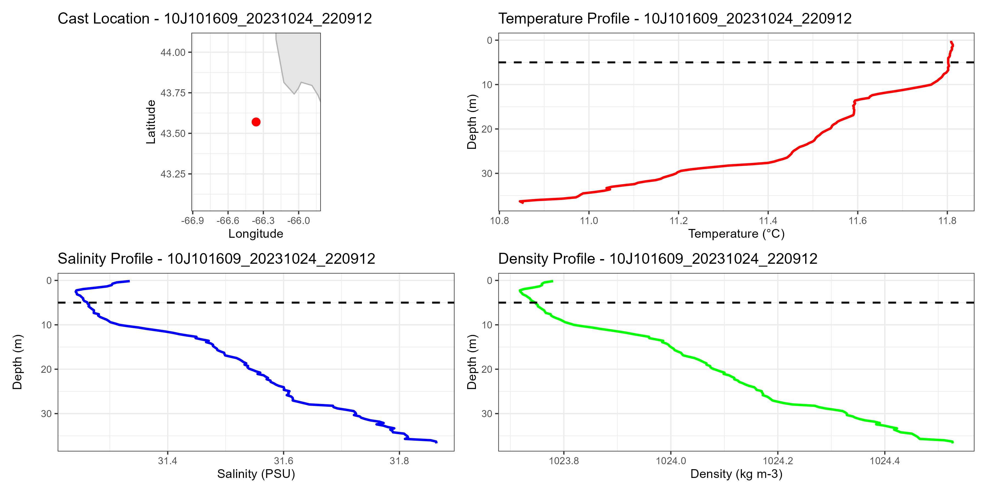
German Bank October 24, 2023 Looks to be salinity only 2.5m

Slide 7
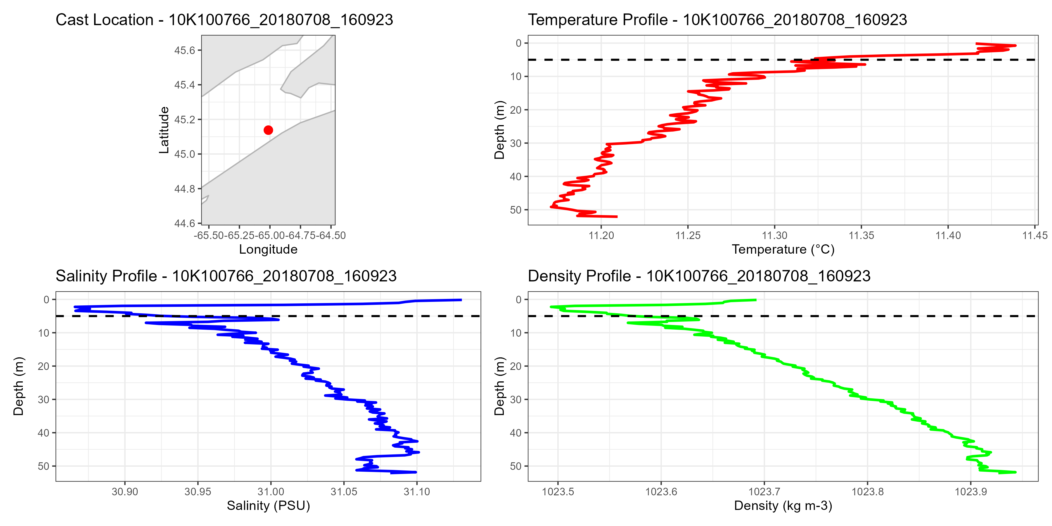
Scots Bay July 8, 2018 5m temperature and salinity

Slide 8
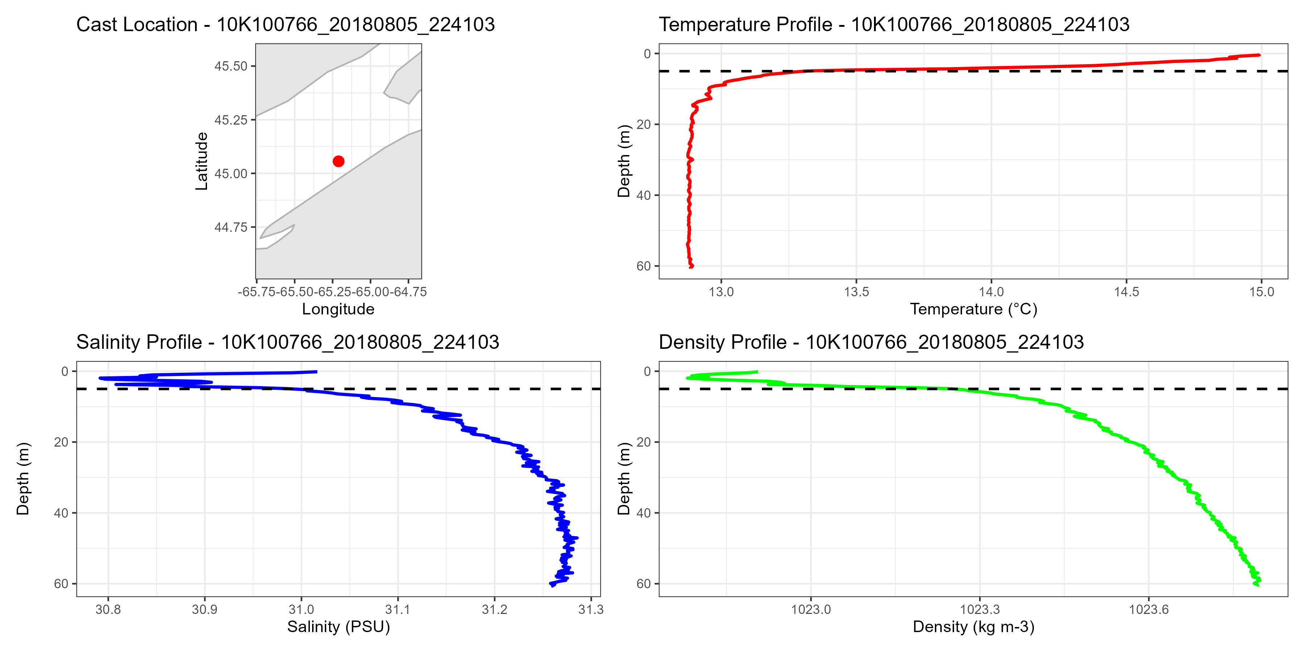
Scots Bay August 5, 2018 Mostly salinity 5m

Slide 9
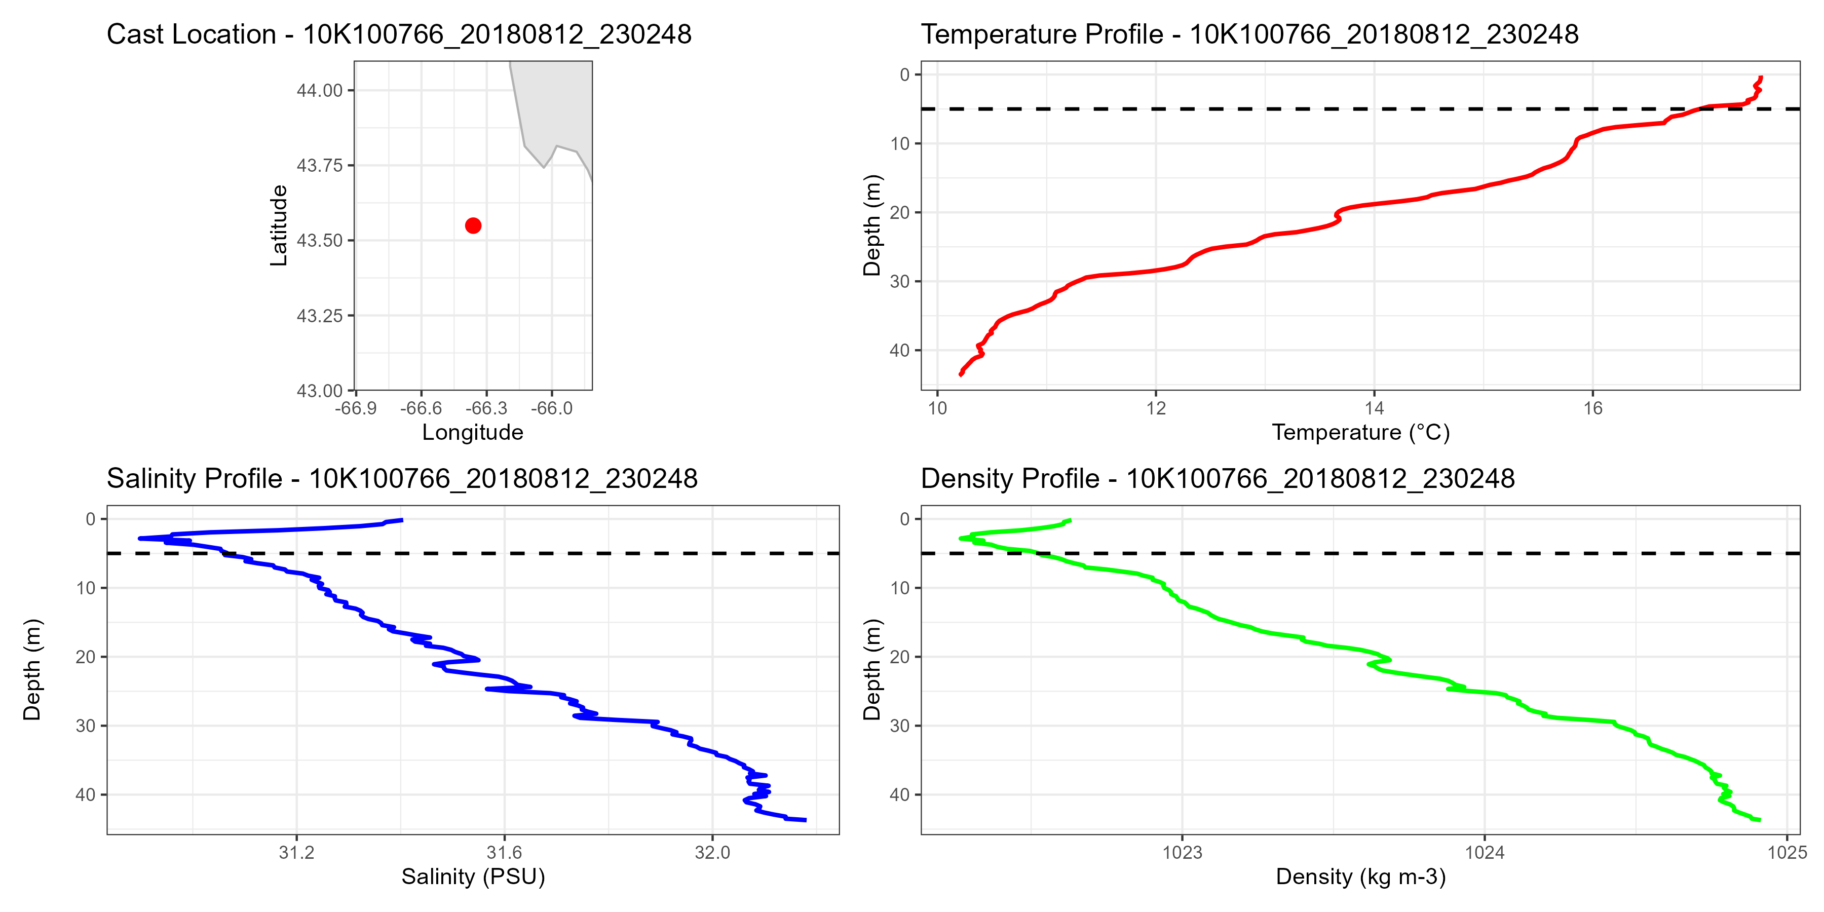
German Bank August 12, 2018 5m, salinity

Slide 10
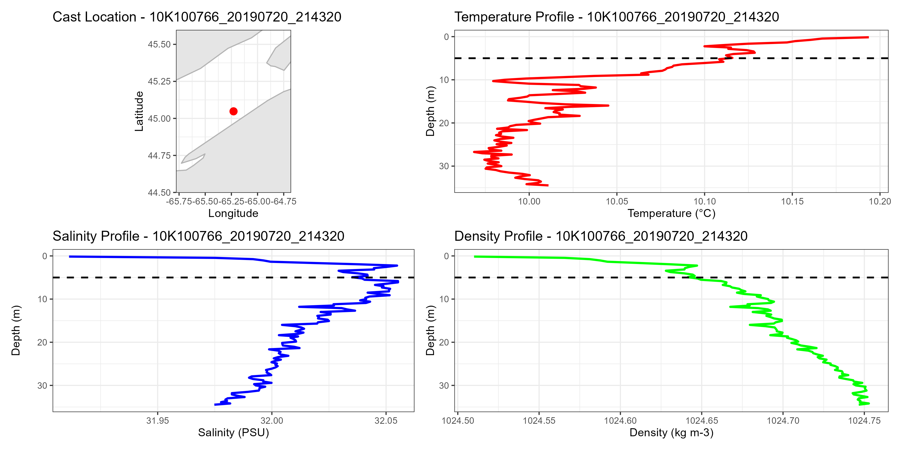
Scots Bay July 20, 2019 5m temperature and salinity

Slide 11
Conclusion for HSC data
Top 5m needs to be trimmed for analysis

Slide 12
DFO Data
Much fewer data points per casts
Often every 10m
Many just a surface and bottom temperature

Slide 13
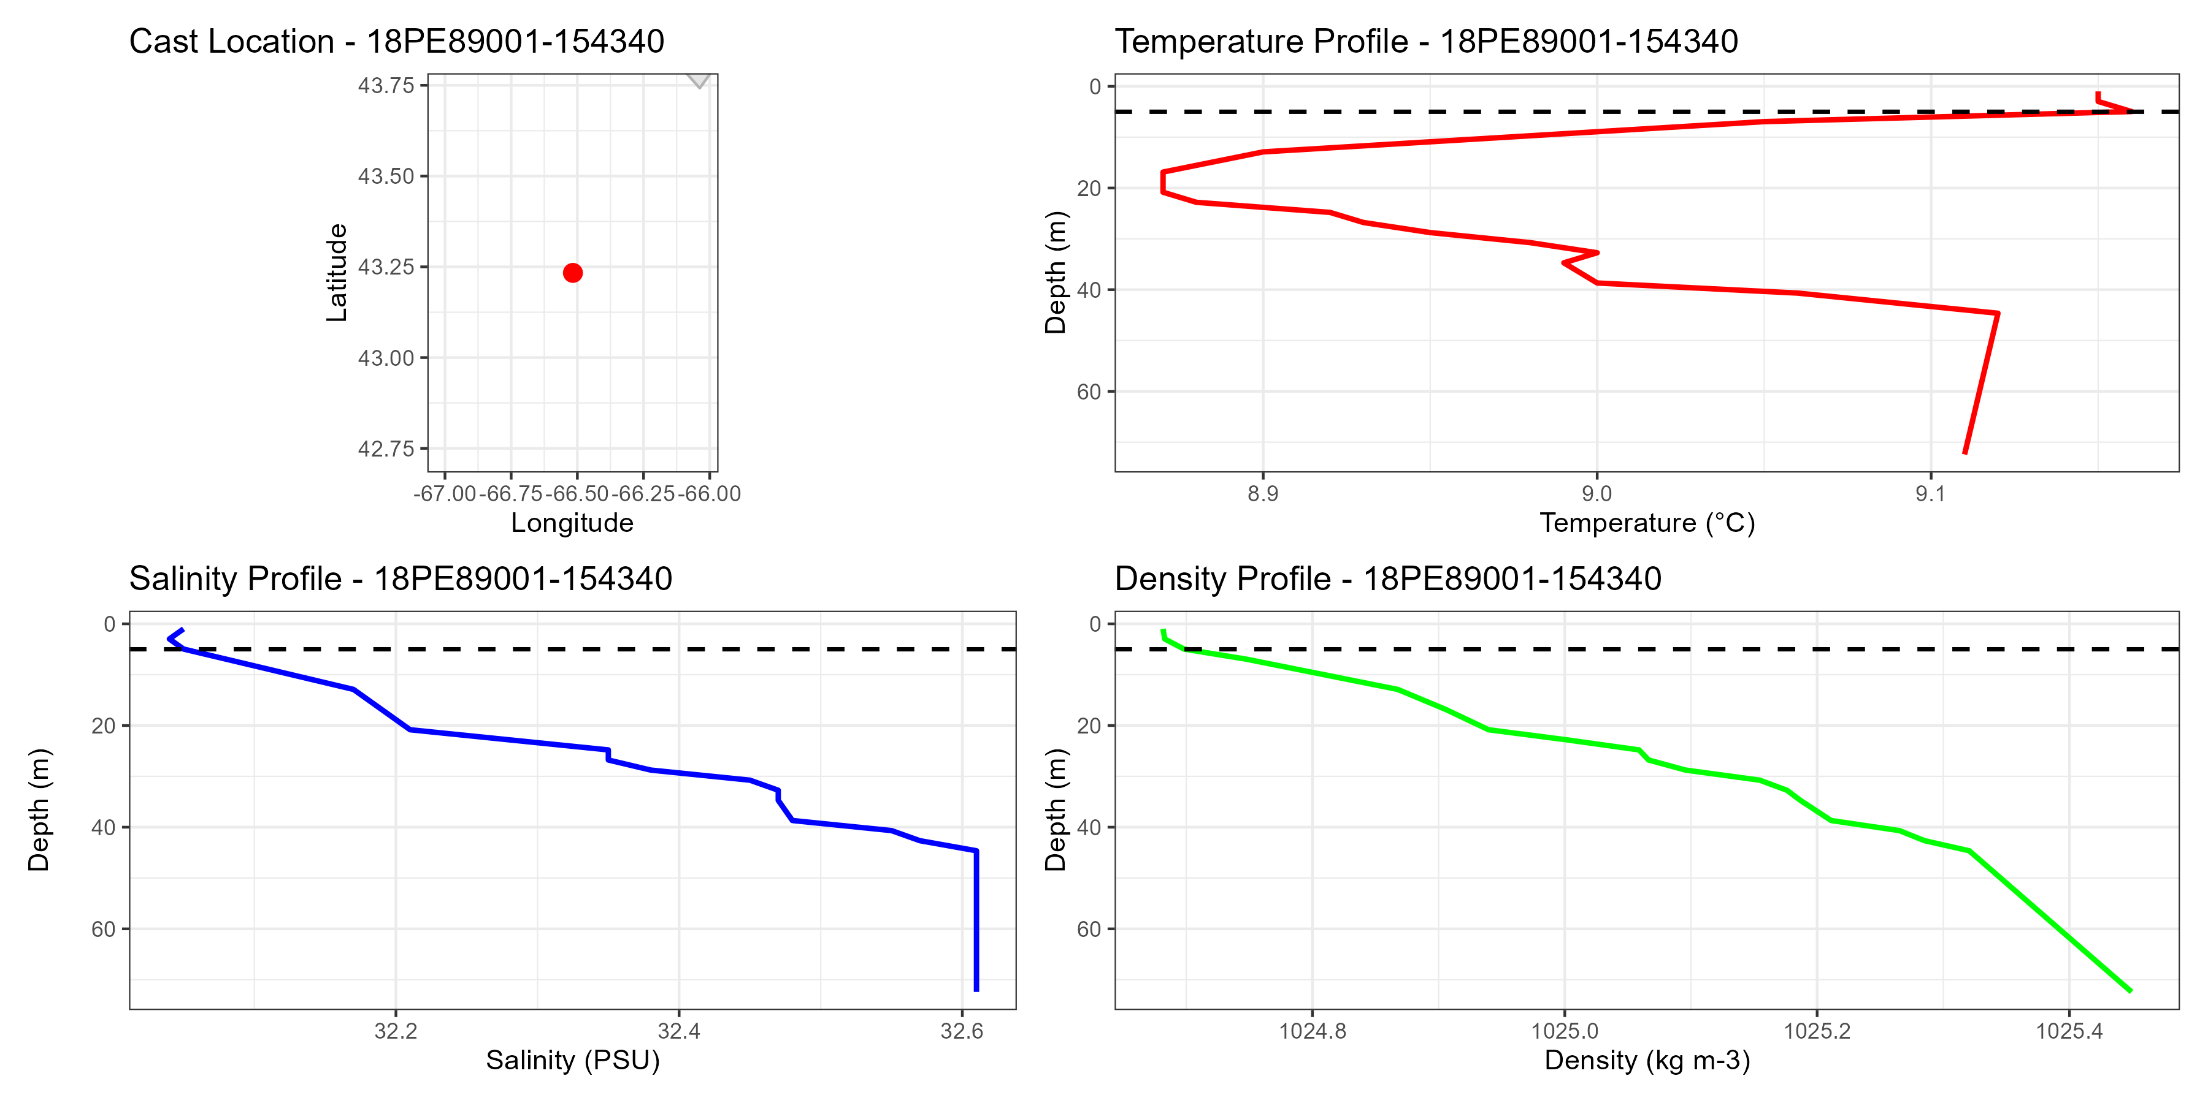
German Bank October 26, 1989 19 data points

Slide 14
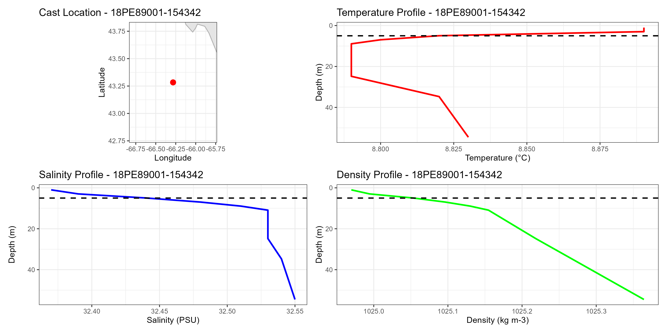
German Bank 9 Data Points October 26, 1989

Slide 15
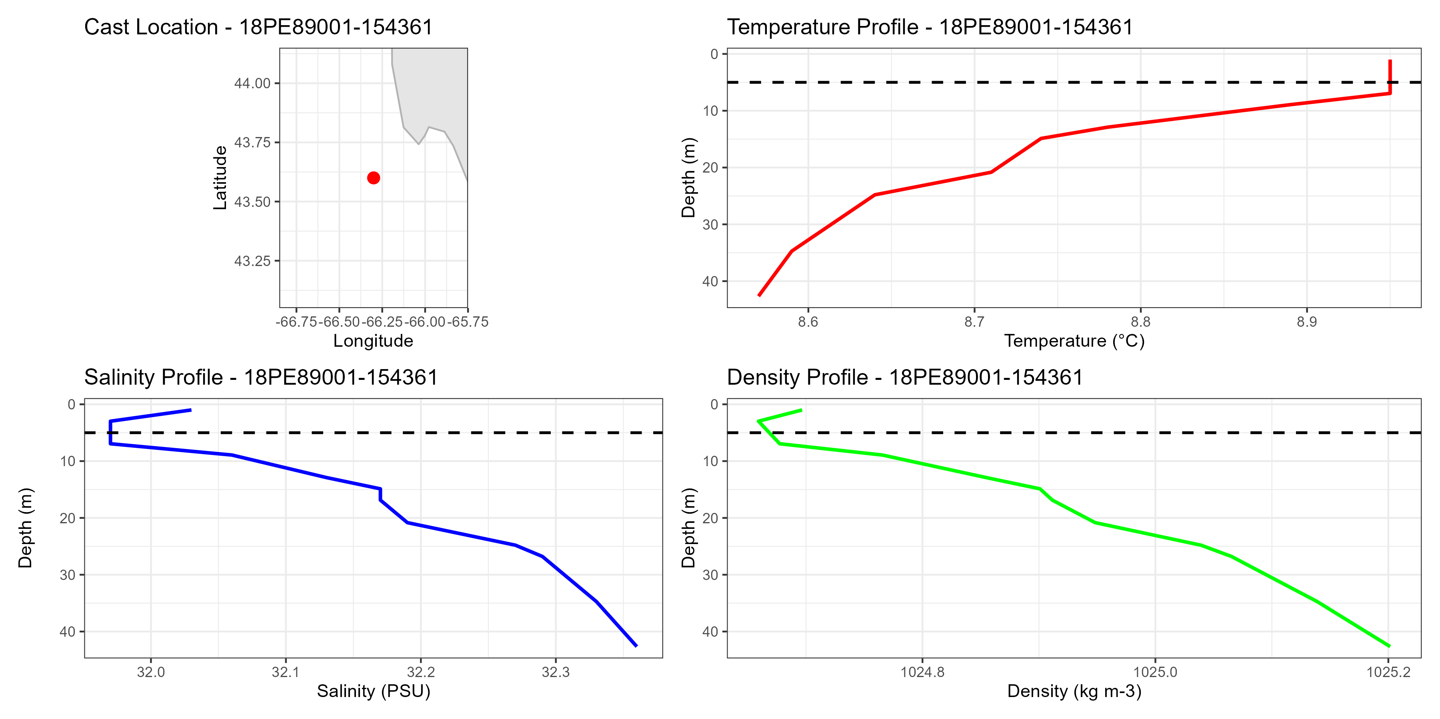
German Bank 12 Data Points October 27, 1989

Slide 16
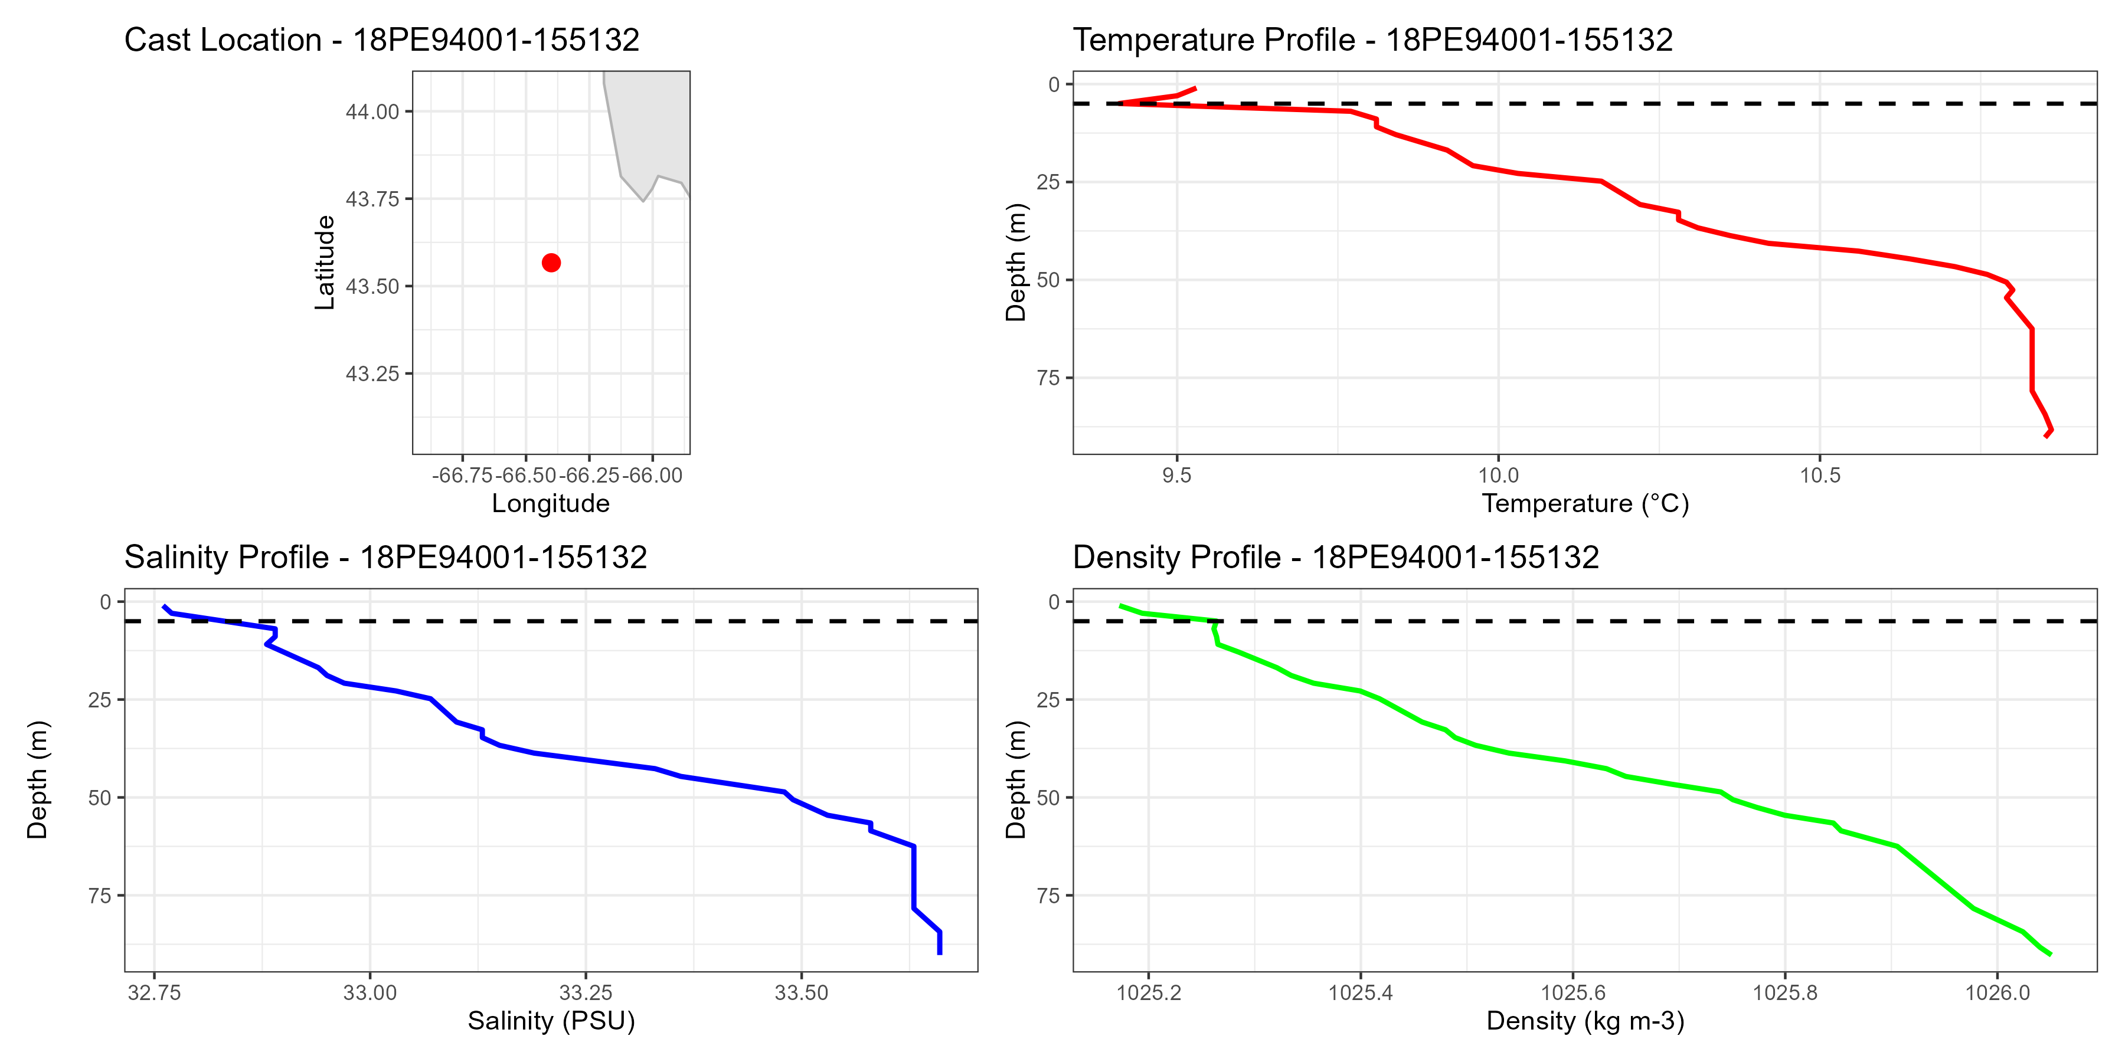
German Bank October 26, 1993 32 data points

Slide 17
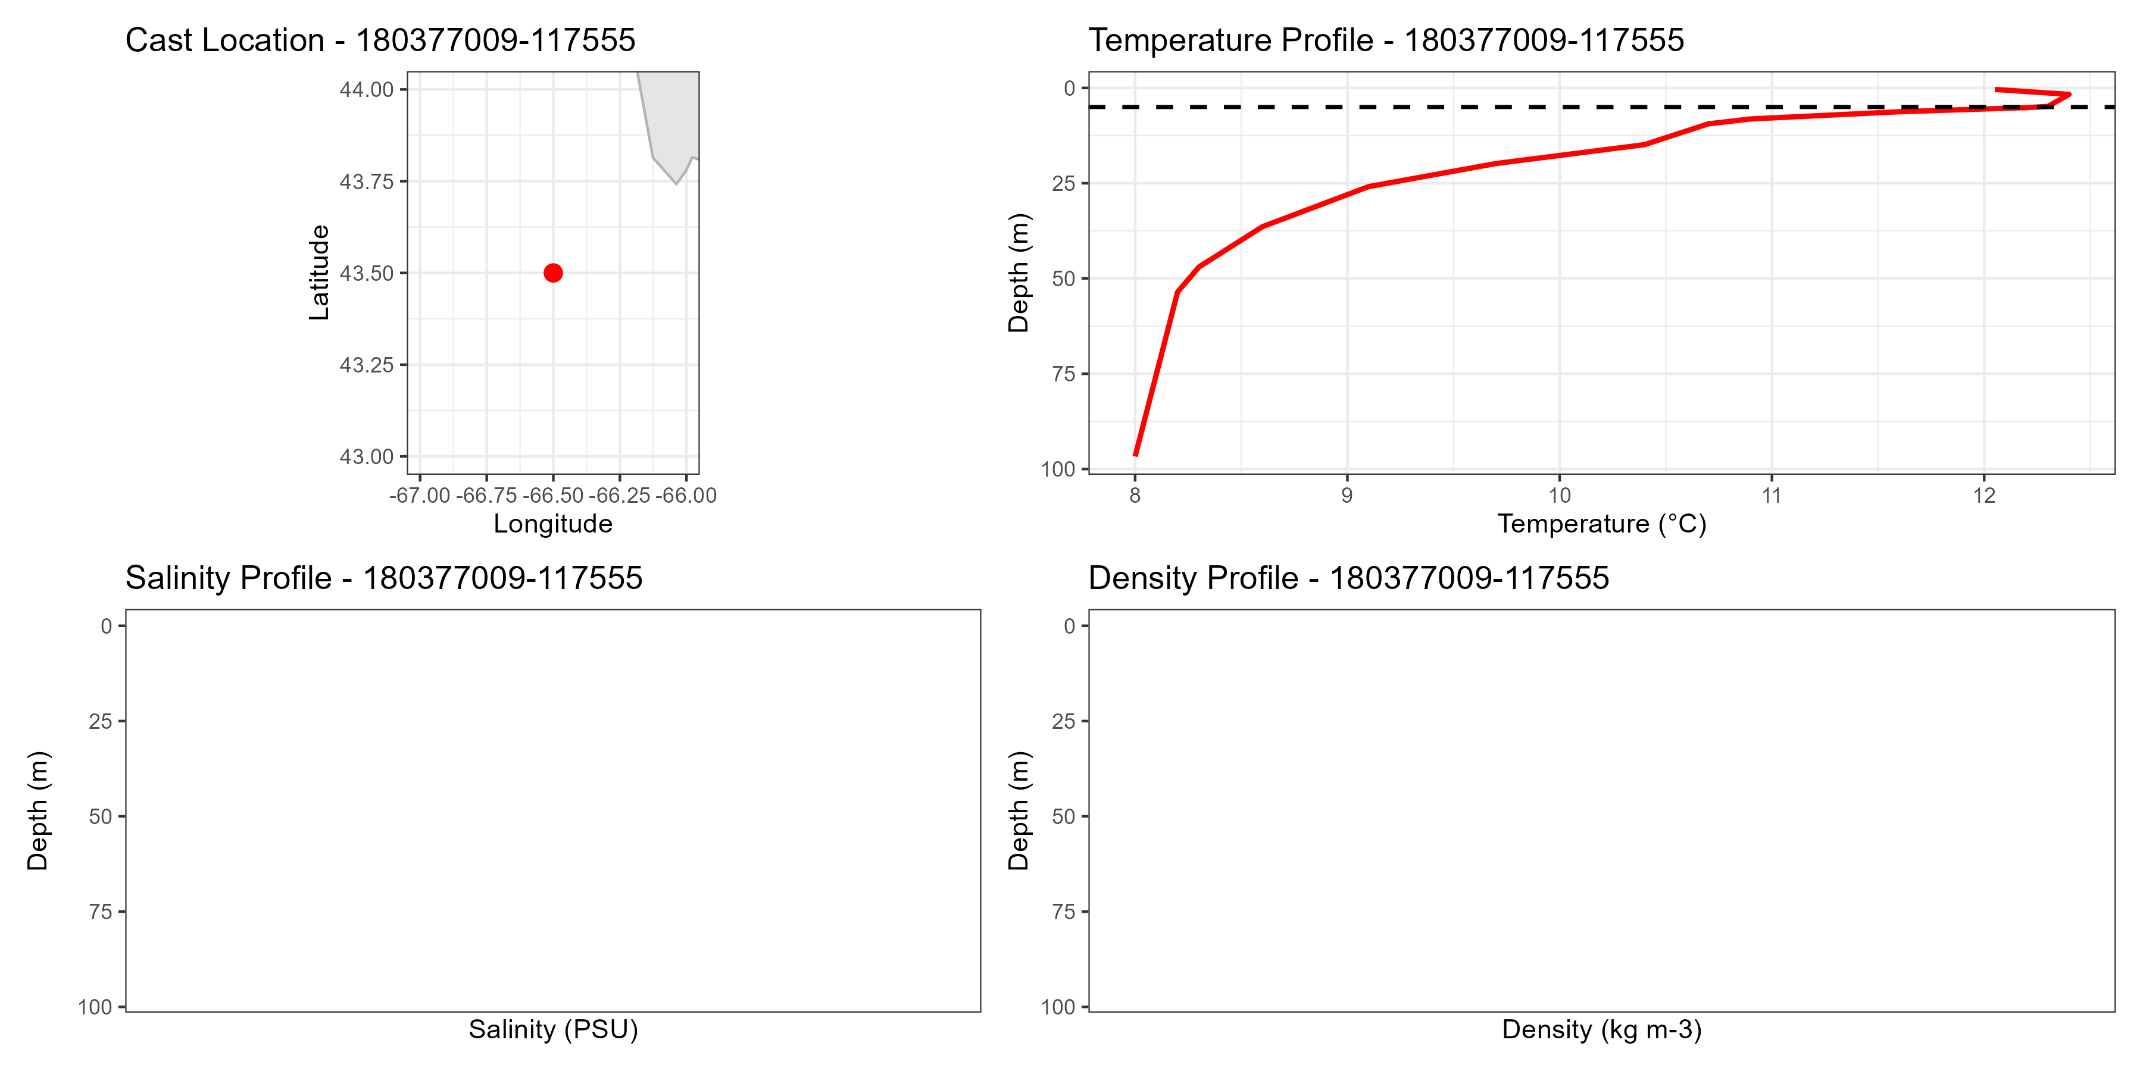
German Bank August 16, 1977 14 data points Temperature only

Slide 18
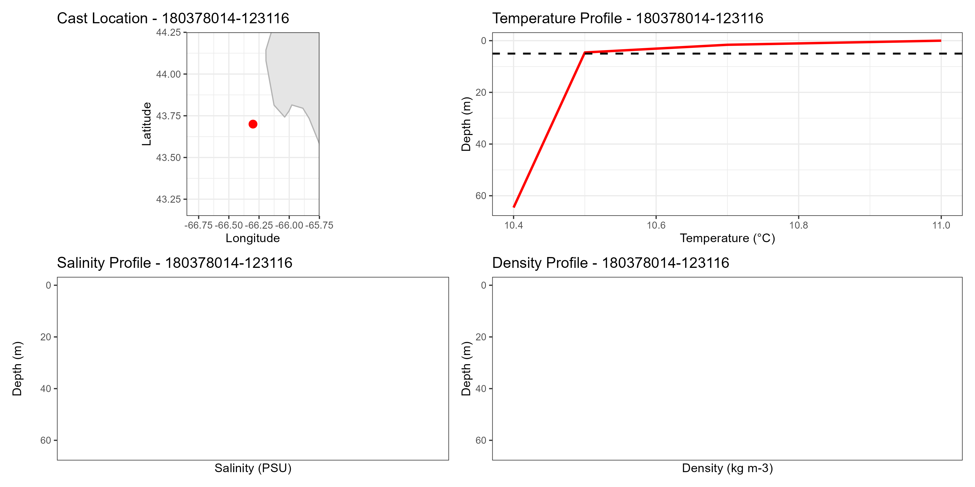
German Bank 4 data points Temperature only August 19, 1978

Slide 19
DFO
Trim top 5 m when there is greater than 2 data points
If less than 2 data points, keep all (greater uncertainty for these casts)
Many historic Scots Bay casts just have surface at 0m, these will have to be compared to an average temp for HSC data (5-10m)

Slide 20
More often effects salinity, but also possible for temperature
Salinity sensor more sensitive than temperature
Occurs in both Scots Bay and German Bank
Occurs in both DFO datasets, historic and 2009
Solution? Trim upper 5 from HSC casts
Conduct a ‘near surface’ comparison
DFO surface temperature with HSC 5-10m

